Slide 1




From Patchwork
to Systems:
Transforming Fragmented Early Learning Funding Streams into a Coherent Funding Strategy with Children and Families at the Center
August 20, 2025
Theresa Hawley, Ph. D
Nasha Patel
Notes:
Introduce yourself with title and role in this work
Welcome to a brief webinar overviewing the early childhood cost modeling the Maine Departments of Human Service and Education are embarking upon in coordination with the Governor's Office, the Children's Cabinet and the ECE Business Collaboratory. This work is central to and funded through a three-year Preschool Development Birth to Five Grant from the Federal Department of Health and Human Services to expand upon the current early childhood strategic plan.
Our goal with this webinar is to introduce you to cost modeling, overview our process and timeline and highlight a few ways you – the provider workforce – can be involved in this important work.

Slide 2




Fragmented Funding
1960s: Response to poverty – Head Start
1970s: Education for Children with Disabilities – IDEA
4 different concerns
4 sets of standards and requirements
4 different bureaucracies working in silos
The pieces don't fit together.
1980s: School Readiness – State Pre-K Programs
1990s: Work Support – CCDBG

Slide 3
What would the system look like if it were redesigned from the point of view of what children and families need?

Slide 4
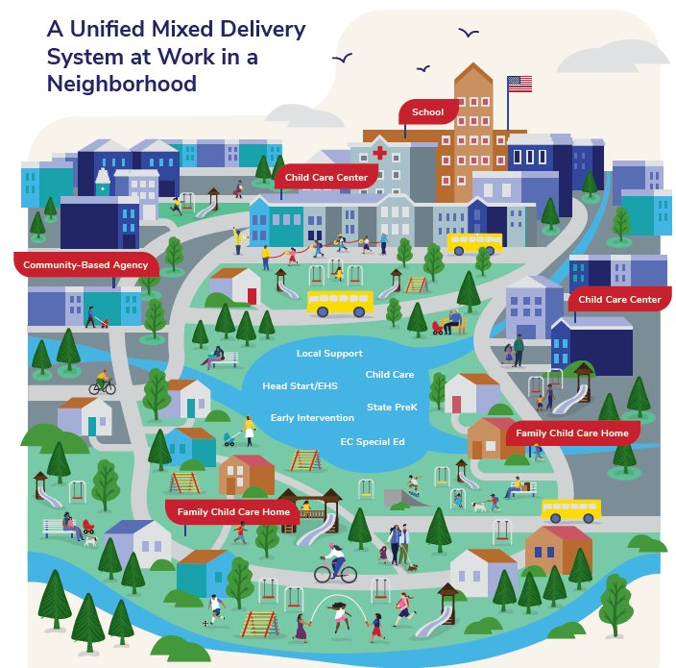
One system drawing from all funding streams ( ) to support all settings ( ).
It supports diverse program models,
each designed to meet family needs.
It is informed by dialogue with
communities.
It reaches those previously left out.
It supports child development and learning in every setting.

Slide 5
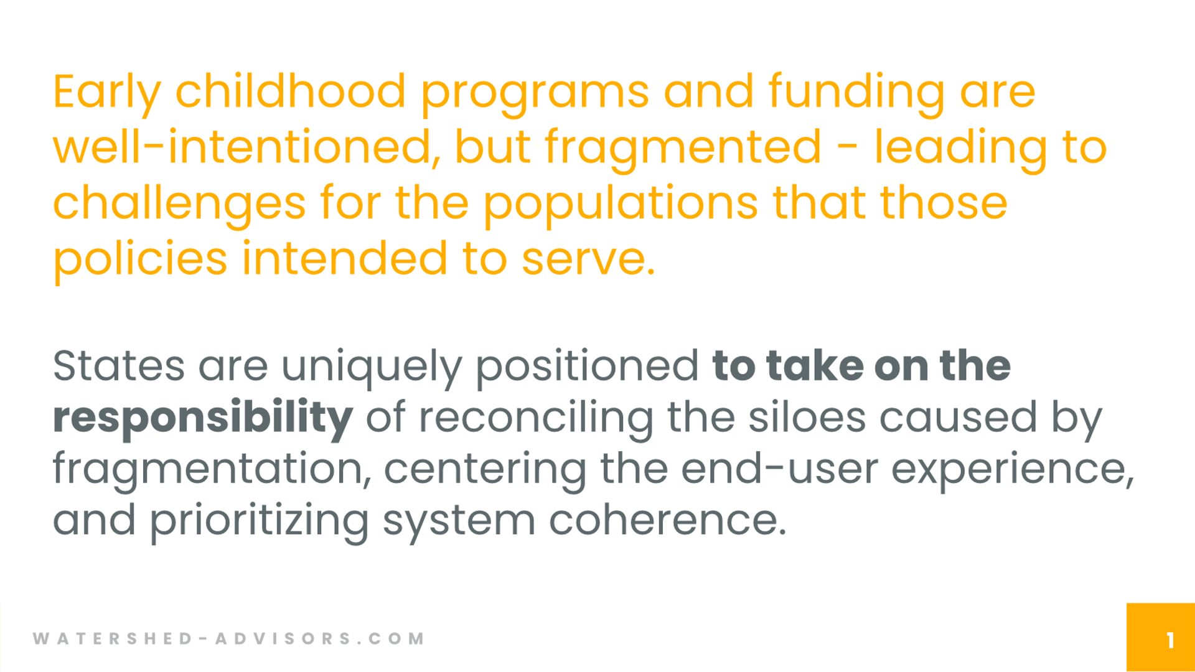

Slide 6
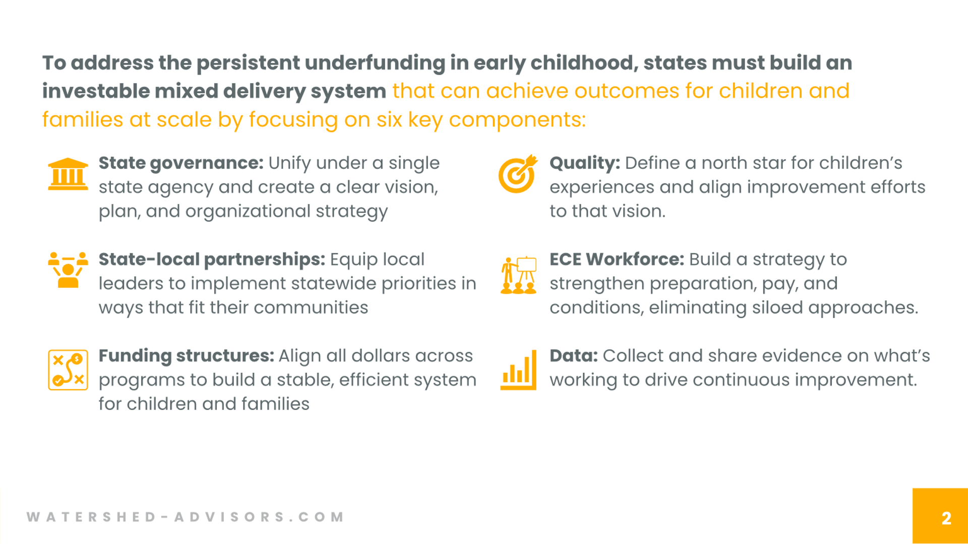

Slide 7
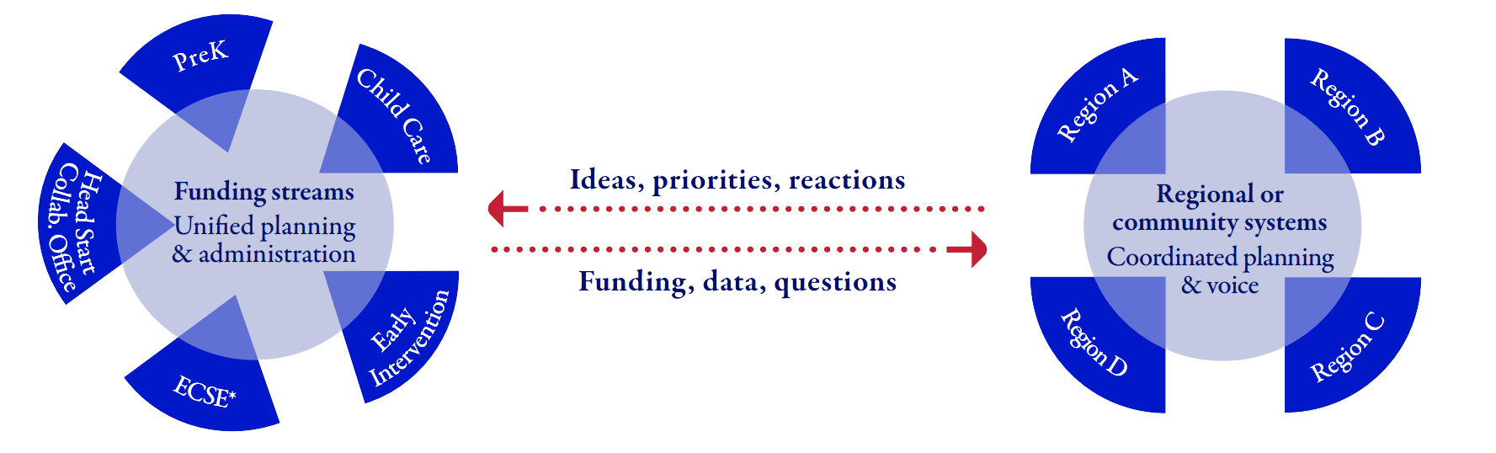
A State-Local Structure
Neither half of this structure can stand on its own. Together, state administrators and community stakeholders can share insights to build a responsive mixed delivery system.
*ECSE (Early Childhood Special Education) funds services for children 3 to 5 years old. Early Intervention funds services for children birth to three.

Slide 8
Implementation: Initial Steps
Center the system on child and community
Look at current child and community need
Look at community resources
Set priorities
Consider which funding streams can address priorities

Slide 9
Implementation Discussion
Examples of next steps

Slide 10
Questions
Notes:
Introduce yourself with title and role in this work
Welcome to a brief webinar overviewing the early childhood cost modeling the Maine Departments of Human Service and Education are embarking upon in coordination with the Governor's Office, the Children's Cabinet and the ECE Business Collaboratory. This work is central to and funded through a three-year Preschool Development Birth to Five Grant from the Federal Department of Health and Human Services to expand upon the current early childhood strategic plan.
Our goal with this webinar is to introduce you to cost modeling, overview our process and timeline and highlight a few ways you – the provider workforce – can be involved in this important work.

Slide 11



What's next?
Upcoming Webinars
Key Resources
Stay Connected
3 future Mixed Delivery System webinars; dates and times TBA:
September: Integrated data systems & community feedback systems
October: Funding coordination at the state and city levels
November: Braided funding contracts at the city level
Join Dr. Theresa Hawley and Nasha Patel at the Build Initiative preconference on 12/2/2025.
From CELFE, read the full Strategy Spotlight, From Mixed Delivery Patchwork to Mixed Delivery Systems.
From Watershed Advisors, read the refreshed Early Childhood Framework.
(Links to both will be shared in the chat and included in a follow-up email.)
What's happening in your state?
  Let us know at info@celfe.org
Follow us on LinkedIn!
Sign up for our newsletter!
(Links will be shared in the chat and included in a follow-up email.)

Slide 12


Thank you!
Theresa Hawley, Ph. D
Executive Director of CELFE
thawley@niu.edu
Nasha Patel
Managing Director of Watershed Advisors
nasha.patel@watershed-advisors.com

