Slide 1

Cost Modeling 101
Cost Model Technical Network 2.0
September 11, 2025

Slide 2

Ice Breaker
Your name
Your organization
ICEBREAKER: If you could choose an afternoon pick-me-up to be delivered to your desk every day, what would it be?

Slide 3

Cost Modeling 101: Getting Real About the True Costs of Child Care
September 11, 2025
Children’s Funding Project
Photo by Allison Shelley/The Verbatim Agency for EDUimages

Slide 4


The Goal for Today
To share our cost modeling course content, approach to capacity building and invite network to share feedback and idea on how the course can support the cost modeling field
Photos by Allison Shelley for EDUimages
Notes:
Call back to ECEC Cost Modeling Convening in 2022:
“Meeting the capacity needed for cost modeling work
Identifying demand for services
Identify ways to build capacity for this work nationally”

Slide 5


OUR “WHY”
Our course inspiration draws from various sources:
Providing education and developing skills to expand the field
Building community, state, and Native Nation capacity
Supporting relationship building to maintain and sustain cost model driven initiatives
Create a standardized framework in a well known area and translate to cradle-to-career programs and services
Photo by Allison Shelley for EDUimages
Notes:
Organizational values of standardized framework
Capturing methodology in well known area to translate to cradle-to-career

Slide 6



Audiences for Course and Coaching
Children’s Funding Coordinators
Cohorts
Individuals
Typical Activities
On demand 1-on-1 coaching support
Initiates and oversees the cost modeling process
Facilitate collaboration between community partners and direct service providers
Educate others in the community to expand capacity and grow cost modeling knowledge
Organization Types
Advocacy organization
State agencies
Policy partners
Typical Activities
Monthly cohort seminars
Team-based approach
Multi-partner efforts
Initiates and oversees the cost modeling process
Share cost model results
Organization Types
Organizations that have interest in other pieces of the strategic financing process (e.g. fiscal mapping)
Typical Activities
Coaching on lesson-based intervals
Initiates and oversees the cost modeling process
Facilitate collaboration between community partners and direct service providers
Notes:
Potential for strategic financing process

Slide 7


Course Structure
Our course structure combines topic content, learning labs and live coaching
Topic Content
Lessons designed to walkthrough the cost modeling process, from “what is a cost model?” to “maintaining and sustaining your model”
Learning Labs
Dynamic spaces for knowledge exchange, where participants engage in Q&A, apply lesson content to their unique contexts, and enhance their skills through practical exercises.
Live coaching
Talk through questions of learners, review work and co-examine cost and policy implications to include in their models
Photo by Allison Shelley/The Verbatim Agency for EDUimages
Notes:
Topic content: More to come on next slide!
Learning lab example: Is there a program, service, goal, or priority that you want to understand how much it costs?
Live coaching: relationships, other work happening, etc.

Slide 8

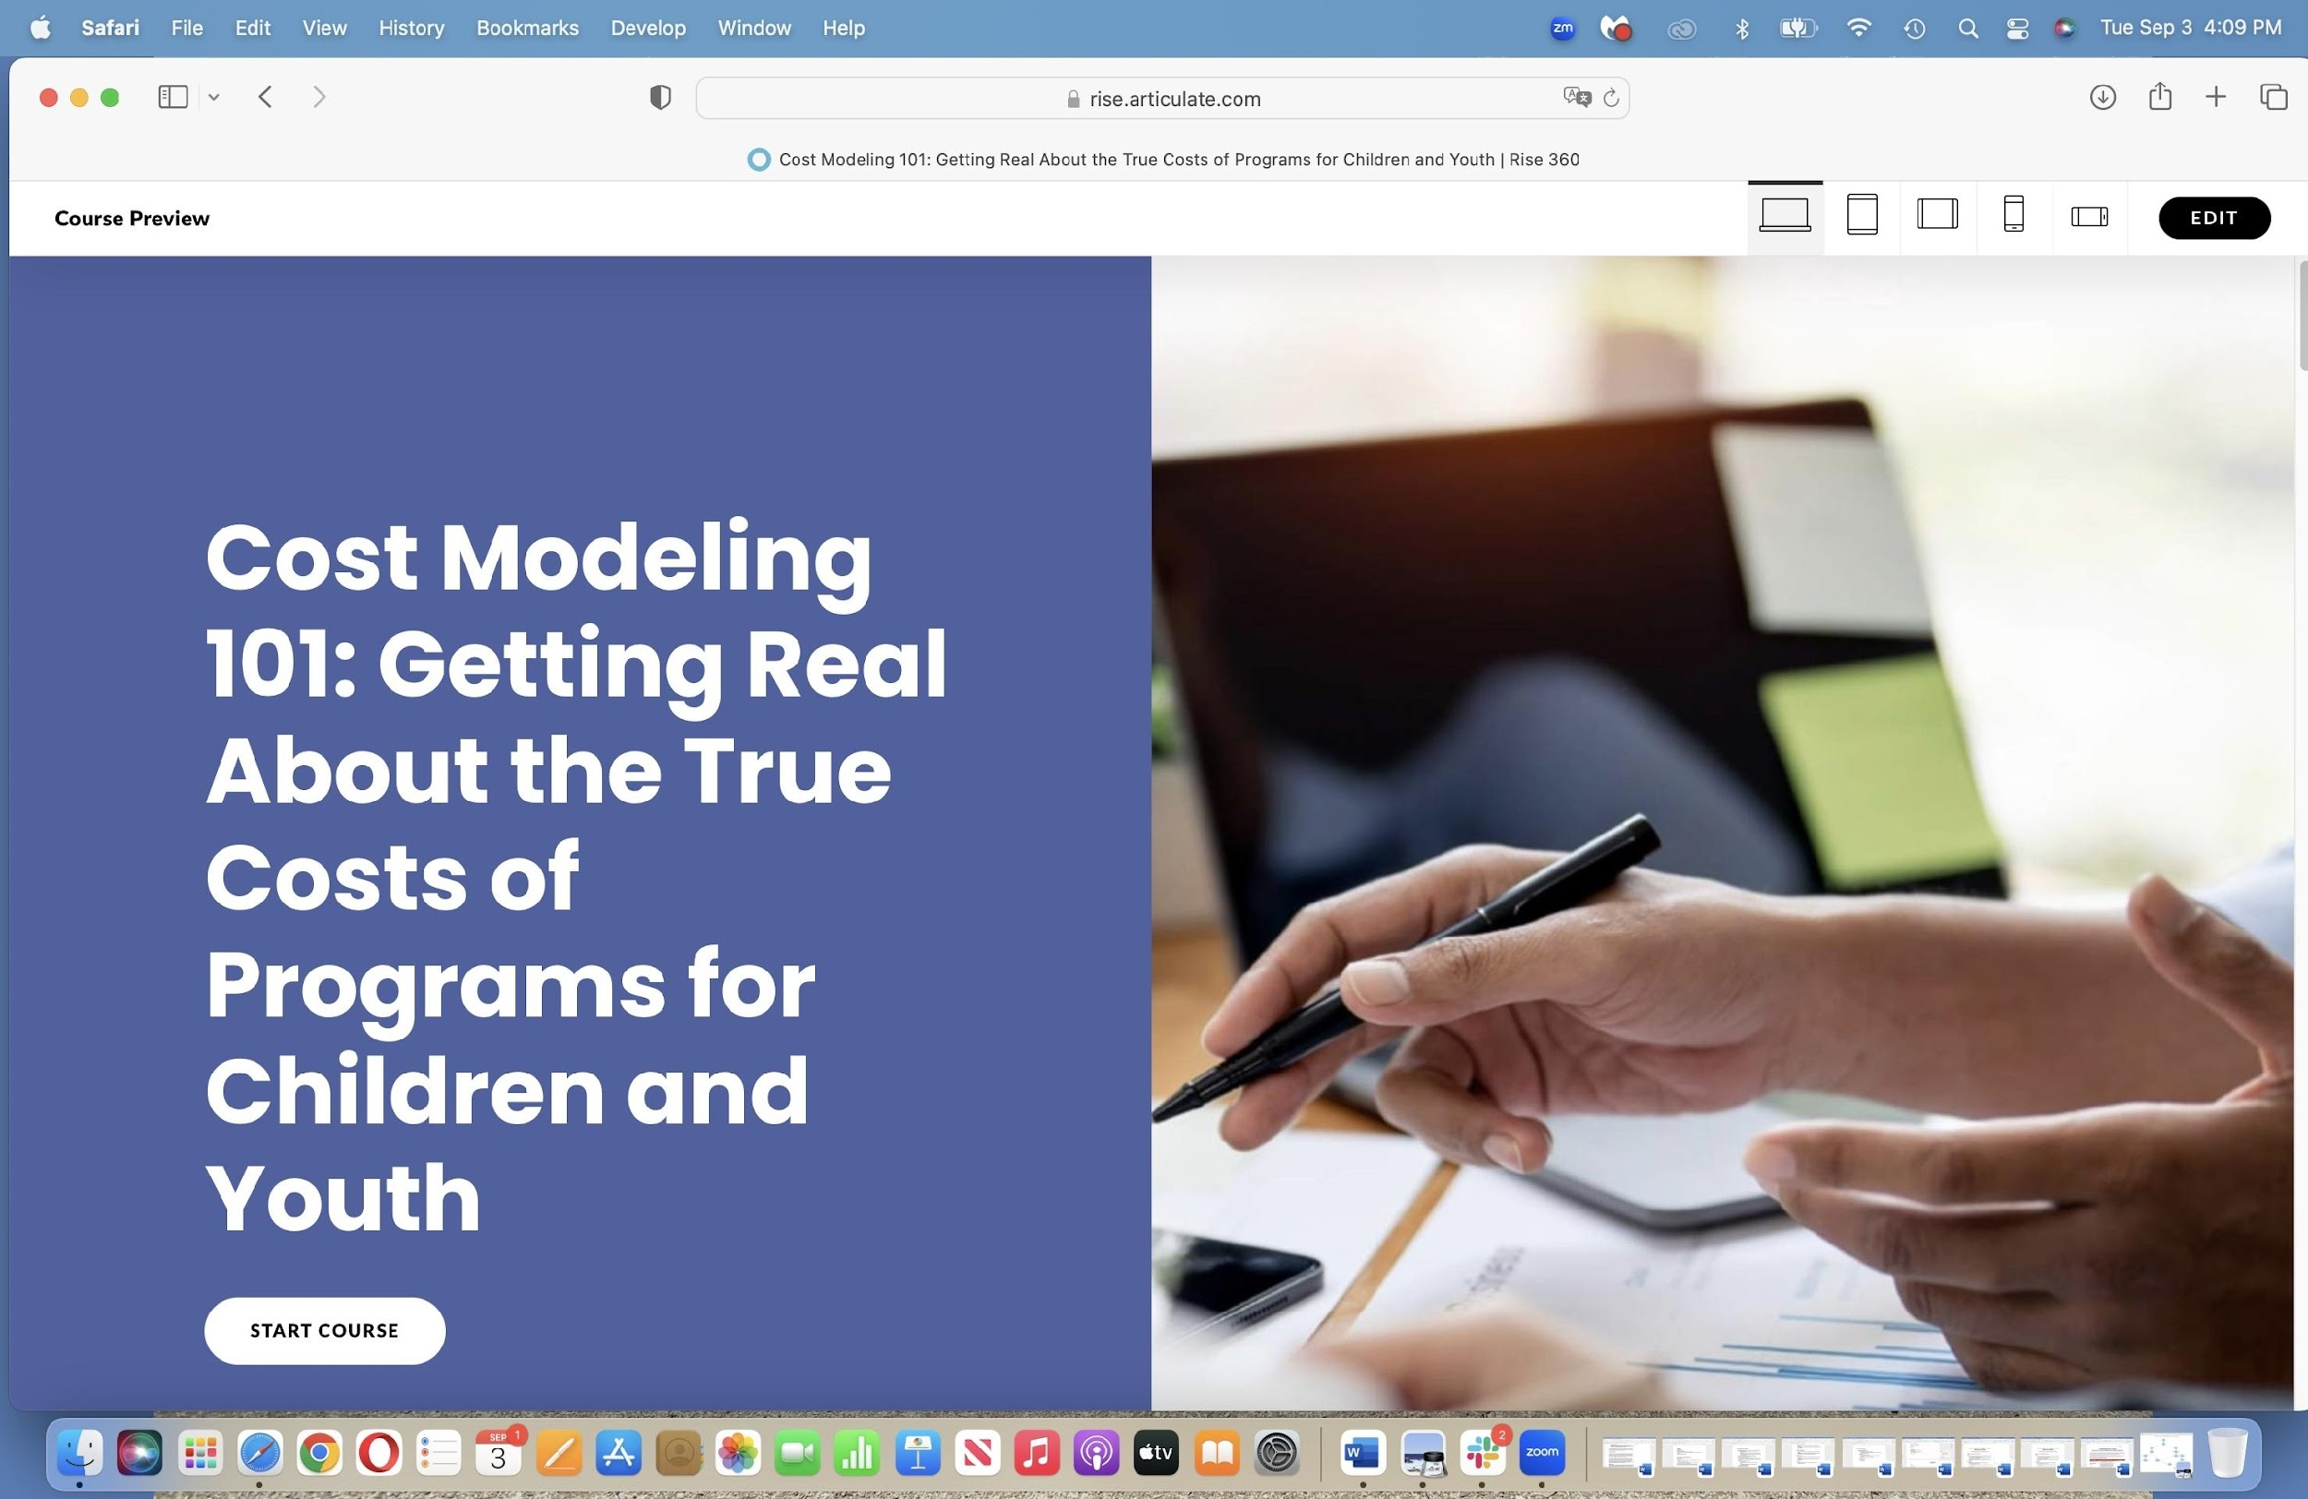
Course Lesson Topics
Our 10 course lessons—combined with our real-time coaching sessions—teach our comprehensive approach to cost modeling to help local leaders and advocates identify the true cost of providing high-quality child care.
Introduction and Overview to Cost Modeling
Children’s Funding Project’s Approach to Cost Modeling
Prioritizing Equity in Cost Modeling
Choosing a Cost Model
Defining Your Cost Model Parameters and Cost Drivers
Aligning Input Data with Parameters in Your Cost Model
Accessing and Collecting Your Cost Model Data
Cleaning Your Data
Building Your Cost Model
Maintaining and Sustaining Your Cost Model

Slide 9
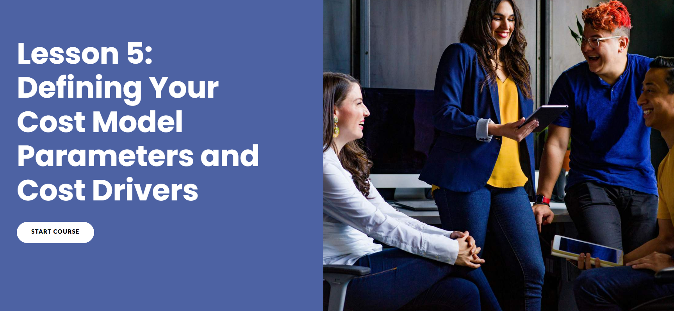

Demo of Cost Modeling 101, Lesson 5

Slide 10
Cost Modeling Cohort Experience
Coached seven state partners to learn our cost modeling process. Each partner developed a model for true cost of high-quality child care for children ages 0-13 in their states.
              Colorado
              Florida
              Hawaii
              Kentucky
              Ohio
              Oklahoma
              Wisconsin
Children’s Funding Project is a nonprofit social impact organization that helps communities, states, and Native nations expand equitable opportunities for children and youth through strategic public financing. childrensfundingproject.org
© Children’s Funding Project, 2025

Slide 11

Questions?
Photo by Allison Shelley for EDUimages

Slide 12
Discussion Questions
How deeply do you train clients to use and change models?
What have you tried when educating clients on cost models?
What about advocates, providers, etc.?
What is challenging about educating people about cost modeling?
What works well?
How can the technical network better support a community of ECEC professionals that incorporate the findings from cost modeling into their work?

Slide 13


Reflection and
Takeaways
What did you learn about today’s session that was new to you or expanded on something you grapple with?
What will you bring into your work?

Slide 14
Closing
Posted Materials –
https://celfe.org/our-work/collaboration/cost-modeling-network/cost-modeling-webinar-series/
Let’s Connect!
Contact info form https://forms.gle/nu8Pyum3kbssMFK59
Next Session:
Thursday November 13th
Cost Modeling for Revenue beyond Child Care Subsidy

Slide 15




Thank you!

